Slide 1
Package management

Slide 2
Software packages and RPM
Many linux apps are modular and depend on other pieces of software
Package managers will check for these dependencies before installing
A Failed Dependency error indicates that one or more of these dependencies has not need satisfied.
Two methods to manage s/w package:
1. created by REDHAT in 1995 --> RPM
2. created by DEBIAN in 1994 --> dpkg

Slide 3
Software packages and RPM
1. RPM (Redhat Package Manager) (2) dpkg (Debian Package Manager)
REDHAT Debian
Centos Ubuntu
Fedora Kali
1. RPM: uses .rpm file extension
--> use YUM (yellow dog updater, modified)
2. dpkg: s/w uses .deb.file extension
--> APT (Advanced Package Tool)

Slide 4
Software packages and RPM
RPM commands:
options used to
-i install specified s/w
-e erase (uninstall) s/w
-v verbose mode for more detail
-h Print bash marks to show progress bar
Syntax:
rpm [option] package name
RPM query:
to know version info.
to list all installed s/w

Slide 5
Software packages and RPM
command: used to
rpm -qa list all installed s/w
rpm -qi packagename list info. about particular package
rpm -qc list configuration files
rpm -qd list document files
example:
rpm -qi iperf
rpm upgrades:
-U: upgrades the installed package and install if package is not installed

Slide 6
Software packages and RPM
The RPM Package Manager, originally developed by Red Hat, provides a standard way to package software for distribution.
It lets administrators track which files were installed by the software package and which ones need to be removed if it is uninstalled, and check to ensure that supporting packages are present when it is installed.
Information about installed packages is stored in a local RPM database on each system.
All software provided by Red Hat for Red Hat Enterprise Linux is provided as an RPM package.

Slide 7
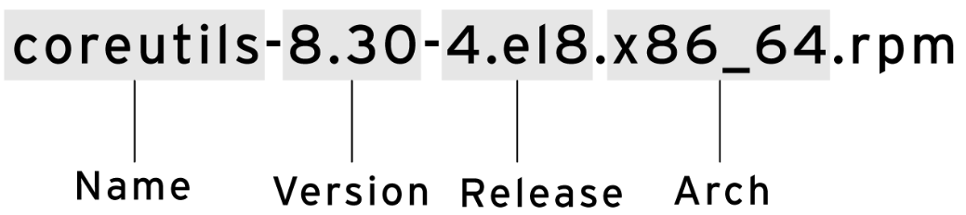
Software packages and RPM
RPM package files names consist of four elements (plus the .rpm suffix): name-version-release.architecture:

Slide 8
Software packages and RPM
NAME is one or more words describing the contents (coreutils).
VERSION is the version number of the original software (8.30).
RELEASE is the release number of the package based on that version, and is set by the packager, who might not be the original software developer (4.el8).
ARCH is the processor architecture the package was compiled to run on. noarch indicates that this package's contents are not architecture-specific (as opposed to x86_64 for 64-bit)

Slide 9
Software packages and RPM
Each RPM package is a special archive made up of three components:
The files installed by the package.
Information about the package (metadata), such as the name, version, release, and arch; a summary and description of the package; whether it requires other packages to be installed; licensing; a package change log; and other details.
Scripts that may run when this package is installed, updated, or removed, or are triggered when other packages are installed, updated, or removed.

Slide 10
Examining RPM Packages
The rpm utility is a low-level tool that can get information about the contents of package files and installed packages.
you can use the -p option to specify that you want to get information about a downloaded package file

Slide 11
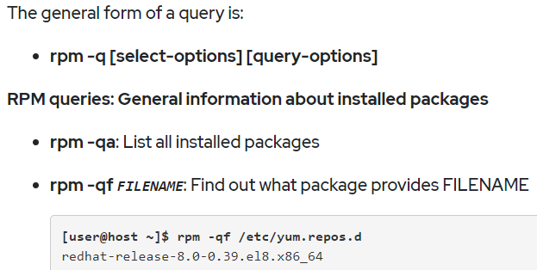
Examining RPM Packages

Slide 12
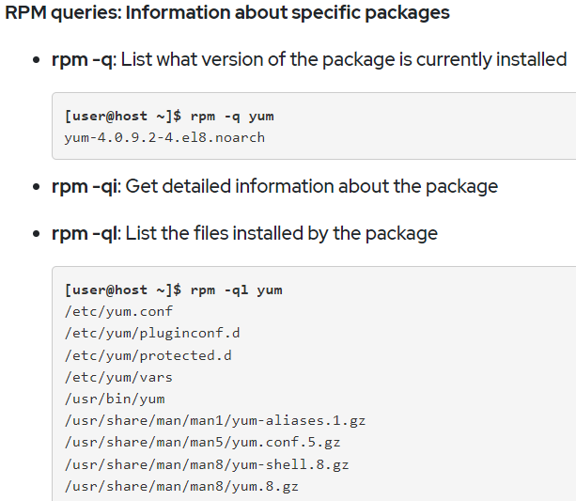
Examining RPM Packages

Slide 13
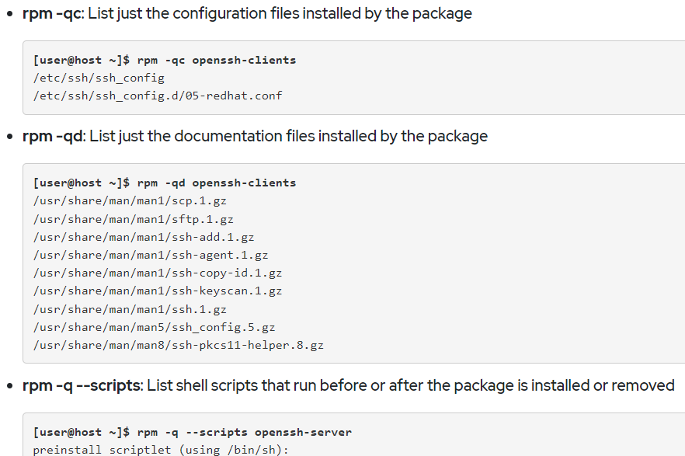
Examining RPM Packages

Slide 14
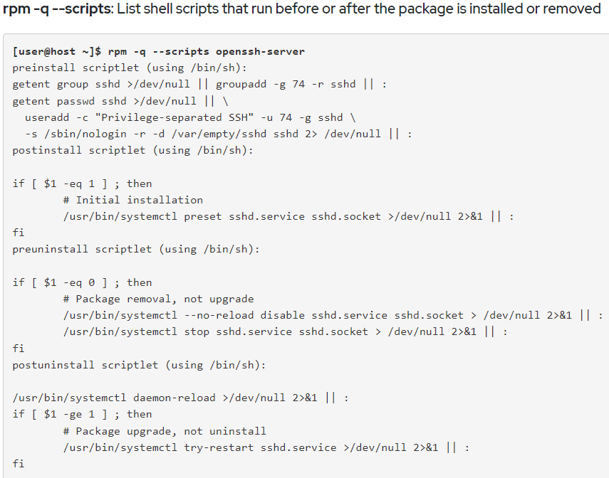
Examining RPM Packages

Slide 15
Examining RPM Packages
rpm -q --changelog: list change information for the package
[user@host ~]$ rpm -q --changelog audit
The rpm command can also be used to install an RPM package that you have downloaded to your local directory.
[root@host ~]# rpm -ivh wonderwidgets-1.0-4.x86_64.rpm
Verifying... ################## [100%]
Preparing... ################## [100%]
Updating / installing...
1:wonderwidgets-1.0-4 ################# [100%]

Slide 16
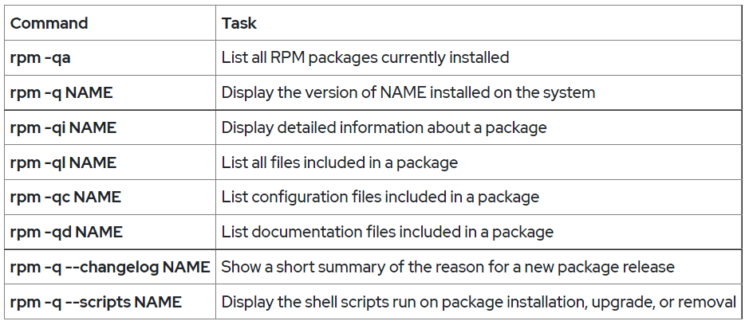
Examining RPM Packages

Slide 17
Managing Software Packages with Yum
yum list 'http*'
yum search KEYWORD lists packages by keywords found in the name and summary fields only.
To search for packages that have “web server” in their name, summary, and description fields, use search all:
[user@host ~]$ yum search all 'web server'

Slide 18
Managing Software Packages with Yum
yum info PACKAGENAME returns detailed information about a package, including the disk space needed for installation.
To get information on the Apache HTTP Server:
[user@host ~]$ yum info httpd
yum provides PATHNAME displays packages that match the path name specified (which often include wildcard characters).
To find packages that provide the /var/www/html directory, use:
[user@host ~]$ yum provides /var/www/html

Slide 19
Installing and removing software with yum
yum install PACKAGENAME obtains and installs a software package, including any dependencies.
[user@host ~]$ yum install httpd
yum update PACKAGENAME obtains and installs a newer version of the specified package, including any dependencies.
yum remove PACKAGENAME removes an installed software package, including any supported packages.
[user@host ~]$ sudo yum remove httpd

Slide 20
Viewing transaction history
All install and remove transactions are logged in /var/log/dnf.rpm.log.
[user@host ~]$ tail -5 /var/log/dnf.rpm.log
yum history displays a summary of install and remove transactions.
[user@host ~]$ sudo yum history
The history undo option reverses a transaction.
[user@host ~]$ sudo yum history undo 5

Slide 21
Viewing transaction history
Enabling Red Hat software repositories
[user@host ~]$ yum repolist all
The yum-config-manager command can be used to enable or disable repositories. To enable a repository, the command sets the enabled parameter to 1.
For example, the following command enables the rhel-8-server-debug-rpms repository:
[user@host ~]$ yum-config-manager --enable rhel-8-server-debug-rpms

Slide 22
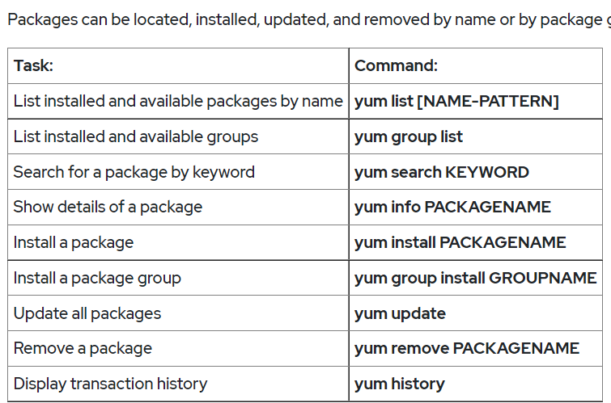
Viewing transaction history

